Slide 1
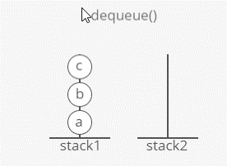
Implement a queue ↴ with 2 stacks. ↴ Your queue should have an enqueue and a dequeue method and it should be "first in first out" (FIFO).
Optimize for the time cost of mm calls on your queue. These can be any mix of enqueue and dequeue calls.
Assume you already have a stack implementation and it gives O(1)O(1) time push and pop.
Gotchas
We can get O(m)O(m) runtime for mm calls. Crazy, right?
Breakdown
Let's call our stacks stack1 and stack2.
To start, we could just push items onto stack1 as they are enqueued. So if our first 3 calls are enqueues of a, b, and c (in that order) we push them onto stack1 as they come in.
But recall that stacks are last in, first out. If our next call was a dequeue() we would need to return a, but it would be on the bottom of the stack.

Slide 2
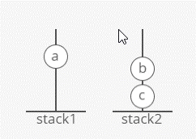
Look at what happens when we pop c, b, and a one-by-one from stack1 to stack2.
Notice how their order is reversed.
We can pop each item 1-by-1 from stack1 to stack2 until we get to a.
We could return a immediately, but what if our next operation was to enqueue a new item d? Where would we put d? d should get dequeued after c, so it makes sense to put them next to each-other . . . but c is at the bottom of stack2.

Slide 3
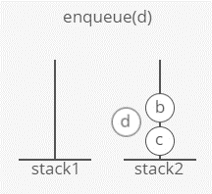
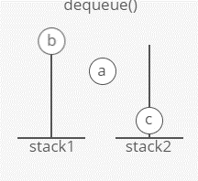
Let's try moving the other items back onto stack1 before returning. This will restore the ordering from before the dequeue, with a now gone. So if we enqueue d next, it ends up on top of c, which seems right.

Slide 4
So we're basically storing everything in stack1, using stack2 only for temporarily "flipping" all of our items during a dequeue to get the bottom (oldest) element.
This is a complete solution. But we can do better.
What's our time complexity for mm operations? At any given point we have O(m)O(m) items inside our data structure, and if we dequeue we have to move all of them from stack1 to stack2 and back again. One dequeue operation thus costs O(m)O(m). The number of dequeues is O(m)O(m), so our worst-case runtime for these mm operations is O(m^2)O(m​2​​).
Not convinced we can have O(m)O(m) dequeues and also have each one deal with O(m)O(m) items in the data structure? What if our first .5m.5m operations are enqueues, and the second .5m.5m are alternating enqueues and dequeues. For each of our .25m.25m dequeues, we have .5m.5m items in the data structure.
We can do better than this O(m^2)O(m​2​​) runtime.
What if we didn't move things back to stack1 after putting them on stack2?

Slide 5
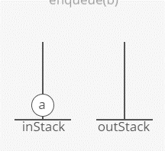
Solution
Let's call our stacks inStack and outStack.
For enqueue, we simply push the enqueued item onto inStack.
For dequeue on an empty outStack, the oldest item is at the bottom of inStack. So we dig to the bottom of inStack by pushing each item one-by-one onto outStack until we reach the bottom item, which we return.
After moving everything from inStack to outStack, the item that was enqueued the 2nd longest ago (after the item we just returned) is at the top of outStack, the item enqueued 3rd longest ago is just below it, etc. So to dequeue on a non-empty outStack, we simply return the top item from outStack.

Slide 6
With that description in mind, let's write some code!
import java.util.NoSuchElementException;
import java.util.Stack;
public class QueueTwoStacks {
private Stack<Integer> inStack = new Stack<>();
private Stack<Integer> outStack = new Stack<>();
public void enqueue(int item) {
inStack.push(item);
}
public int dequeue() {
if (outStack.empty()) {
// Move items from inStack to outStack, reversing order
while (!inStack.empty()) {
int newestInStackItem = inStack.peek();
outStack.push(newestInStackItem);
inStack.pop();
}
// If outStack is still empty, raise an error
if (outStack.empty()) {
throw new NoSuchElementException("Can't dequeue from empty queue!");
}
}
return outStack.pop();
}
}

Slide 7
Complexity
Each enqueue is clearly O(1)O(1) time, and so is each dequeue when outStack has items. Dequeue on an empty outStack is order of the number of items in inStack at that moment, which can vary significantly.
Notice that the more expensive a dequeue on an empty outStack is (that is, the more items we have to move from inStack to outStack), the more O(1)O(1)-time dequeues off of a non-empty outStack it wins us in the future. Once items are moved from inStack to outStack they just sit there, ready to be dequeued in O(1) time. An item never moves "backwards" in our data structure.
We might guess that this "averages out" so that in a set of mm enqueues and dequeues the total cost of all dequeues is actually just O(m)O(m). To check this rigorously, we can use the accounting method, ↴ counting the time cost per item instead of per enqueue or dequeue.
So let's look at the worst case for a single item, which is the case where it is enqueued and then later dequeued. In this case, the item enters inStack (costing 1 push), then later moves to outStack (costing 1 pop and 1 push), then later comes off outStack to get returned (costing 1 pop).
Each of these 4 pushes and pops is O(1)O(1) time. So our total cost per item is O(1)O(1). Our mm enqueue and dequeue operations put mm or fewer items into the system, giving a total runtime of O(m)O(m).
What We Learned
People often struggle with the runtime analysis for this one. The trick is to think of the cost per item passing through our queue, rather than the cost per enqueue() and dequeue().
This trick generally comes in handy when you're looking at the time cost of not just one call, but "m" calls.

